Slide 1
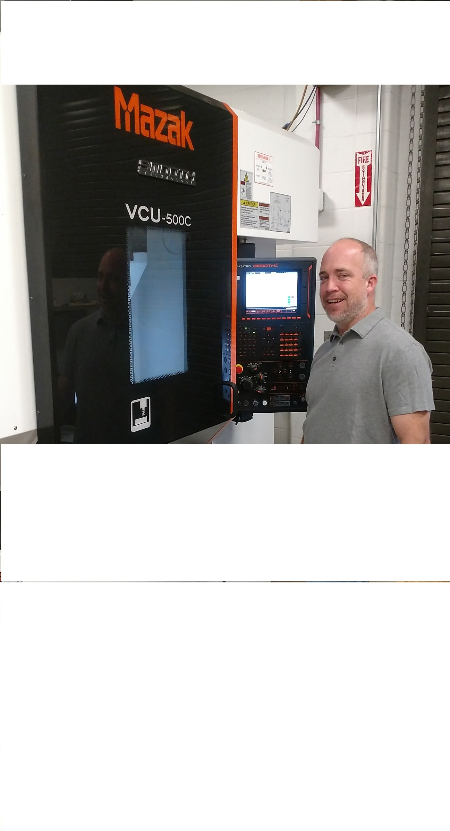
Mr. Jeff Ricketts
Machinist /CAD CAM Specialist
Engineering Student Machine Shop
University of Delaware

Slide 2
Biography
Graduated from Cecil County School of Technology with a Machining certificate in 1993.
Studied Mechanical Engineering at Del Tech 1999.
Received my Journeyman's papers from the state of Pennsylvania in 2001.
I started working in my family's fabrication shop when I was 10, where I learned welding and sheet metal fabrication.
I started working in a machine shop in 1991 and have worked in the medical, defense, automotive and aerospace industries.

Slide 3
Biography page 2
I have been with the University since 2012 working in the Engineering machine shop located in Colburn labs.
I enjoy teaching machining ,welding and fabrication techniques.
My hobbies include restoring antique cars, building race cars, tinsmithing, restoring early structures and furniture.

